Slide 1
U.S Regional sales data

Slide 2
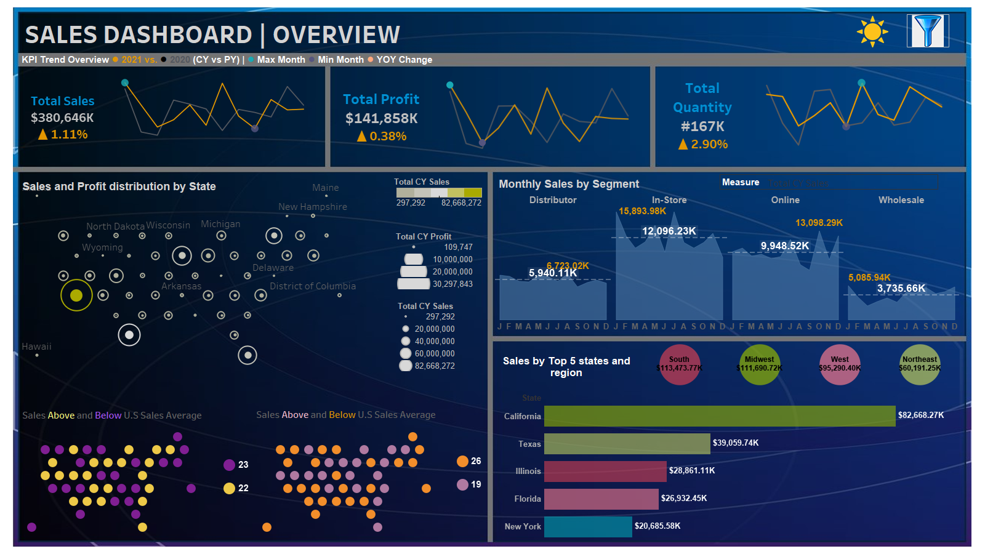

Slide 3
